Slide 1
Model Interpretability: Basics, Methods and Opportunities
Shenda Hong
2018/12/06

Slide 2
Model Interpretability Basics

Slide 3
Definition of Interpretability
Interpretability is the degree to which a human can
understand the cause of a decision
consistently predict the model’s result
A model is better interpretable than another model if its decisions are easier for a human to comprehend than decisions from the second model.

Slide 4
The Importance of Interpretability
If a machine learning model performs well, why don’t you just trust the model and ignore why it made a certain decision? “The problem is that a single metric, such as classification accuracy, is an incomplete description of most real-world tasks.”
From what to why (the nature of humanity)
why this prediction
why a model might fail
The model itself becomes the source of knowledge instead of the data. Interpretability makes it possible to extract this additional knowledge captured by the model.

Slide 5

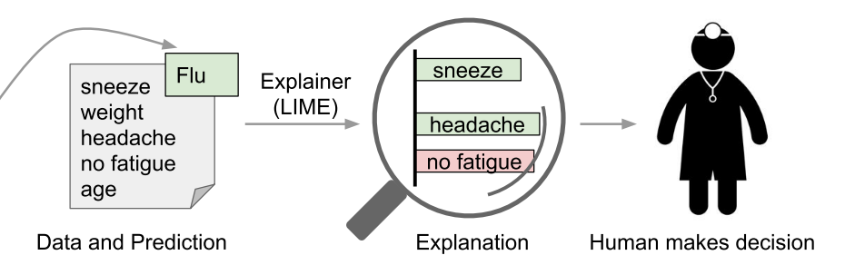
The Importance of Interpretability
Risk Factor
Phenotypes
Biomarkers

Slide 6
Scope of Interpretability
Algorithm transparency
How does the algorithm create the model?
CNN, multiple levels
LSE in LR, BP in DNN with millions of parameters
Global, Holistic Model Interpretability
How does the trained model make predictions?
global model interpretability is very hard to achieve in practice
Locally
Global Model Interpretability on a Modular Level
How do parts of the model influence predictions?
Decision trees better than linear model
Local Interpretability for a Single Prediction
Why did the model make a specific decision for an instance?
Local Interpretability for a Group of Predictions
Why did the model make specific decisions for a group of instances?

Slide 7
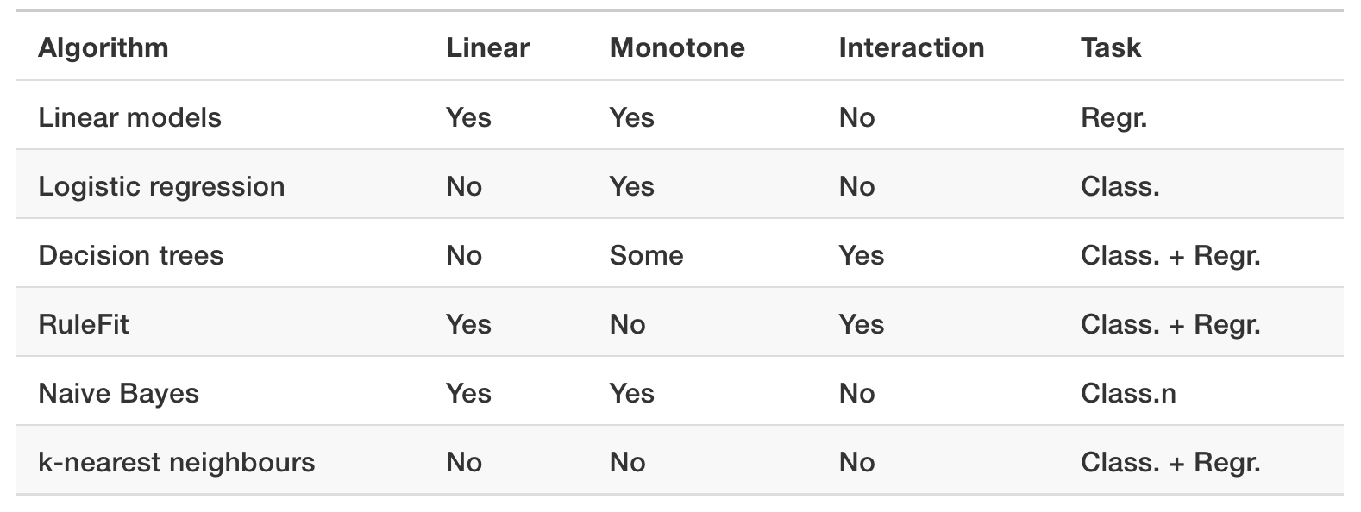
Taxonomy
Build Interpretable Model
Interpret Agnostic Model
Deep Neural Networks
Ensemble Methods: GBDT, RF

Slide 8
Another Taxonomy
Feature summary statistic
feature importance scores
Feature summary visualization
partial dependence plots
Model internals
weights in linear models
learned tree structure
attention weights
filters in CNN
subgraphs
Data point
similar data point
prototypes
Intrinsically interpretable model
Model surrogates

Slide 9
Evaluations
Completeness compared to the original model
how closely it approximates the original model being explained
Completeness as measured on a substitute task
a salience explanation that is intended to reveal model sensitivity can be evaluated against a brute-force measurement of the model sensitivity
Ability to detect models with biases
presence or absence of a relevant bias
Human evaluation
case study
Gilpin L H, Bau D, Yuan B Z, et al. Explaining Explanations: An Approach to Evaluating Interpretability of Machine Learning[J]. arXiv preprint arXiv:1806.00069, 2018. Citation 9

Slide 10
Reading List
NIPS 2017 Interpretable ML Symposium
http://interpretable.ml
ICML 2017 Tutorial
http://people.csail.mit.edu/beenkim/papers/BeenK_FinaleDV_ICML2017_tutorial.pdf
Book
https://christophm.github.io/interpretable-ml-book/
Github awesome
https://github.com/lopusz/awesome-interpretable-machine-learning
https://github.com/jphall663/awesome-machine-learning-interpretability

Slide 11
Methods of Build Interpretable Model

Slide 12
Simple Model
Linear
Tree
Rule
Statistics and probability
Instance

Slide 13
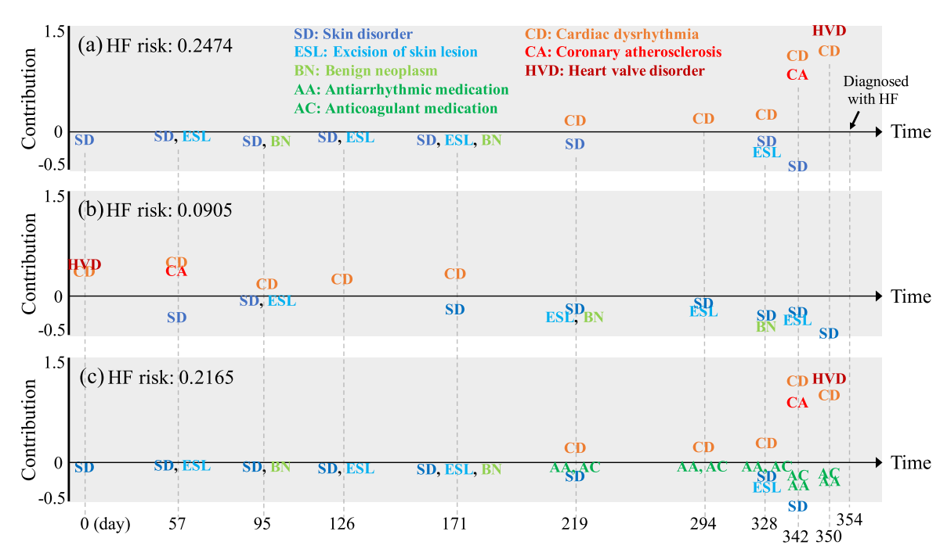
Attention Mechanism
Choi E, Bahadori M T, Sun J, et al. Retain: An interpretable predictive model for healthcare using reverse time attention mechanism[C]//Advances in Neural Information Processing Systems. 2016: 3504-3512.

Slide 14
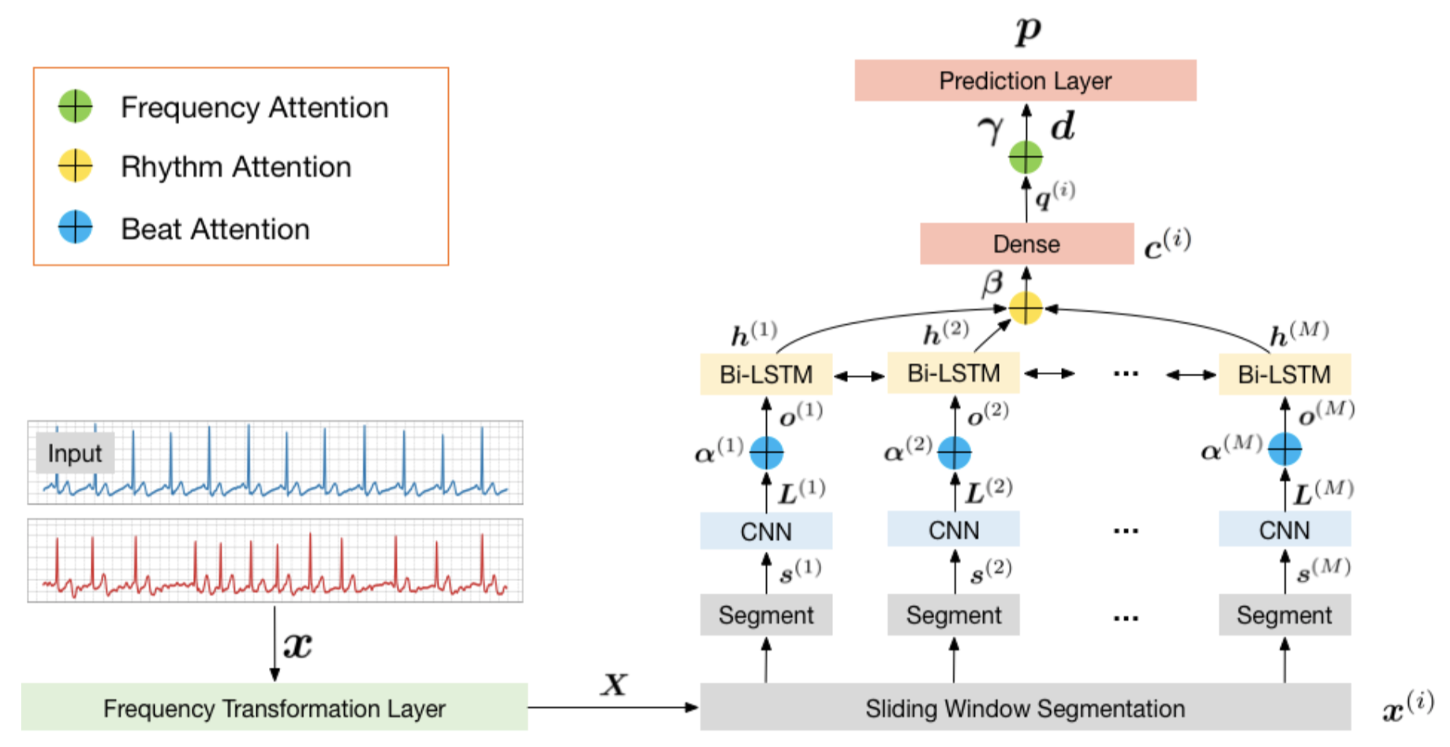
External Knowledge Guided Architecture Design
MINA: Multilevel Knowledge-Guided Attention for Modeling Electrocardiography Signals

Slide 15
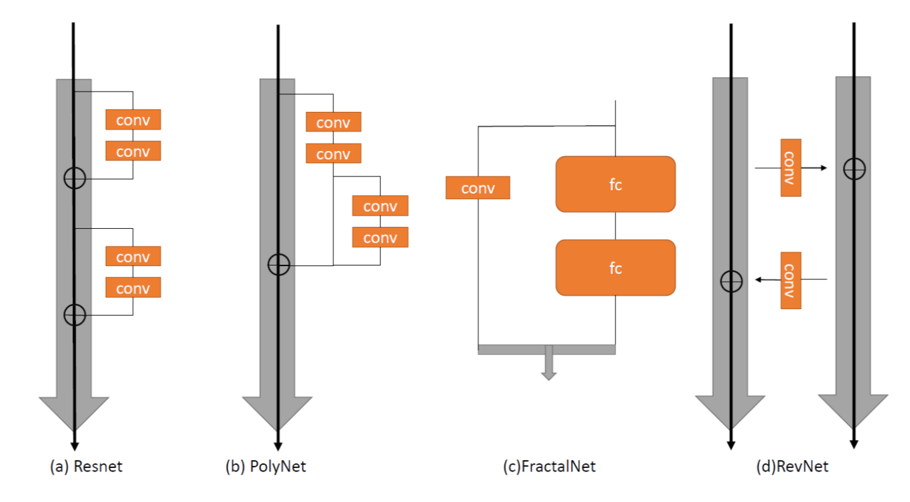
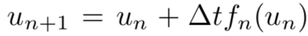
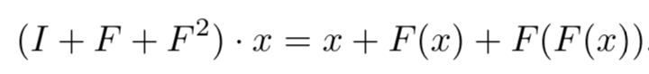
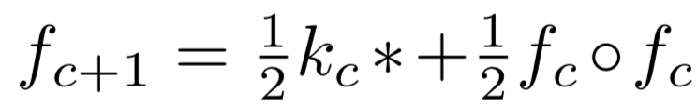
Internal Knowledge Guided Architecture Design
ResNet
PolyNet
FractalNet
RevNet
Lu Y, Zhong A, Li Q, et al. Beyond finite layer neural networks: Bridging deep architectures and numerical differential equations[J]. ICML, 2018.

Slide 16
Methods of Interpret Agnostic Model

Slide 17
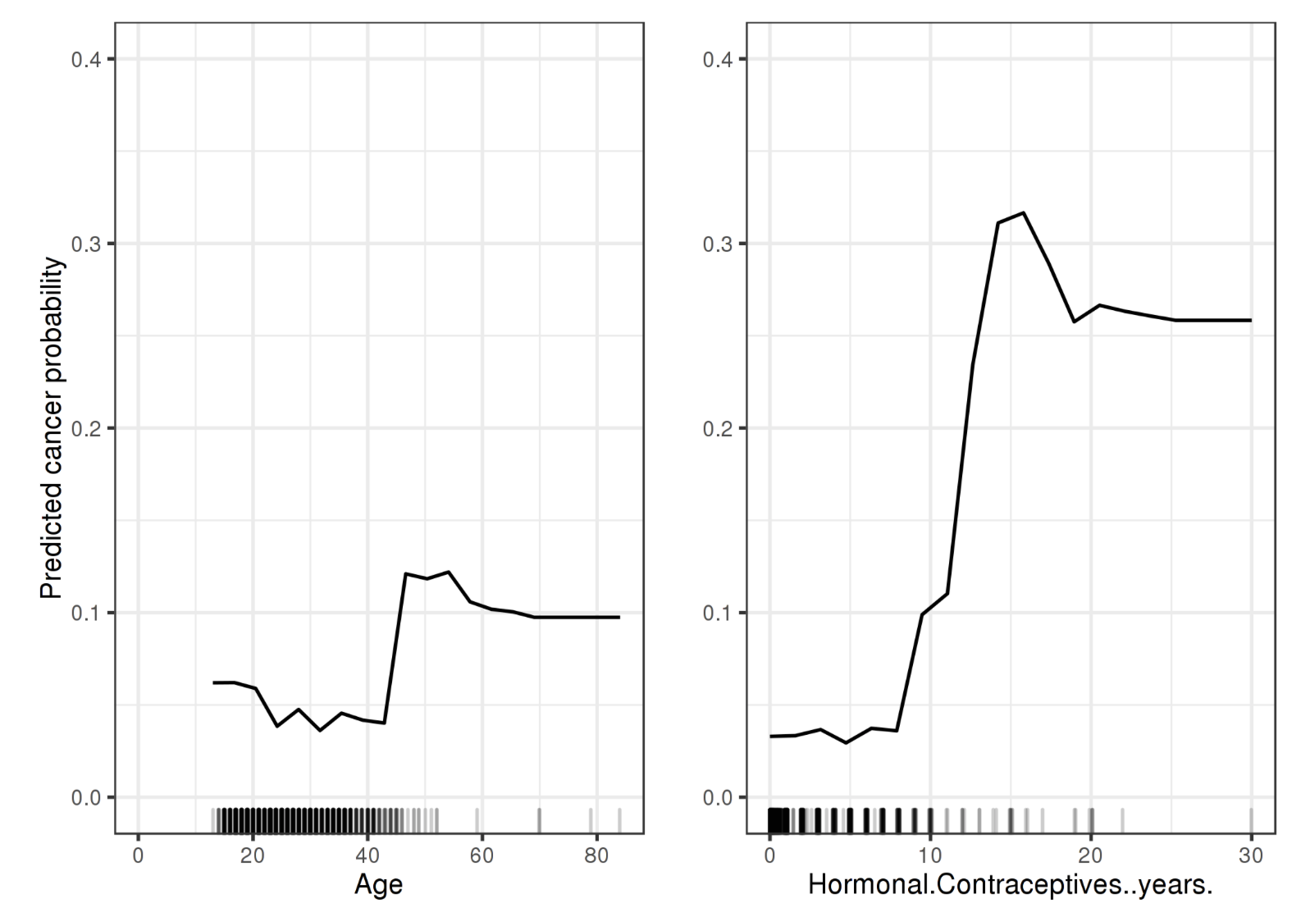
Visualization
Partial Dependence Plot
Friedman, Jerome H. 2001. “Greedy Function Approximation: A Gradient Boosting Machine.” Annals of Statistics. JSTOR, 1189–1232.↩

Slide 18
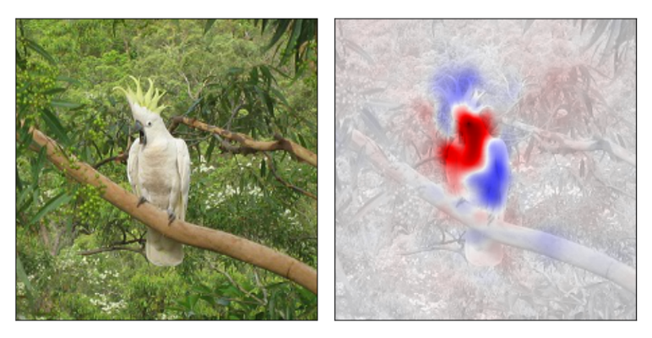
Visualization
Saliency map
Zintgraf L M, Cohen T S, Adel T, et al. Visualizing deep neural network decisions: Prediction difference analysis. ICLR 2017

Slide 19
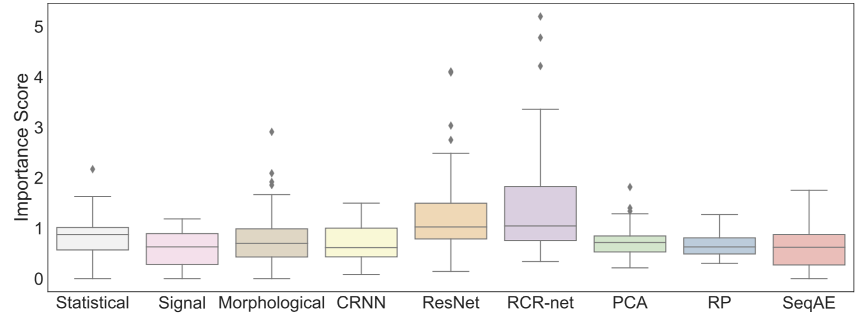
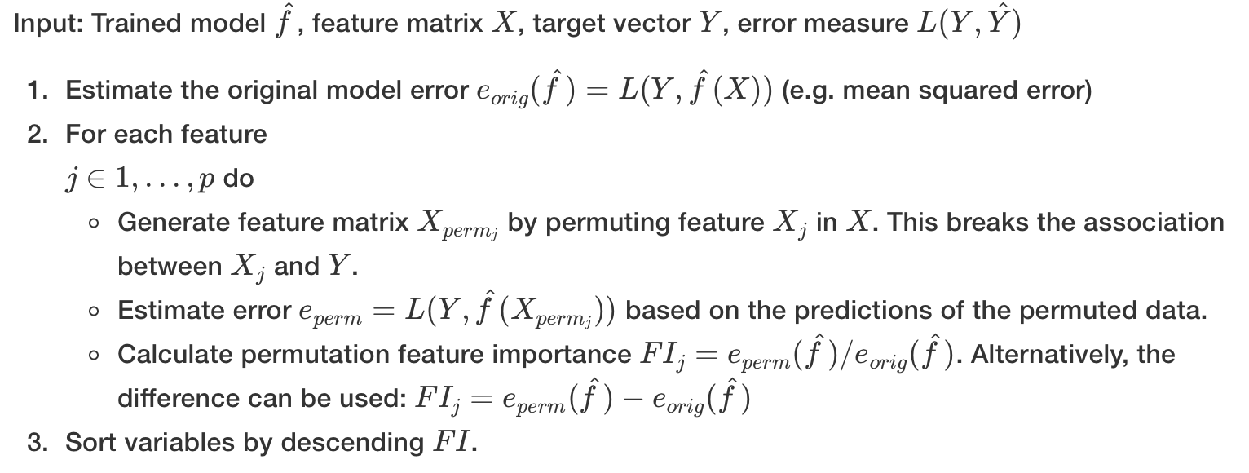
Feature Importance
Importance score
Breiman, Leo. 2001. “Random Forests.” Machine Learning 45 (1). Springer: 5–32

Slide 20
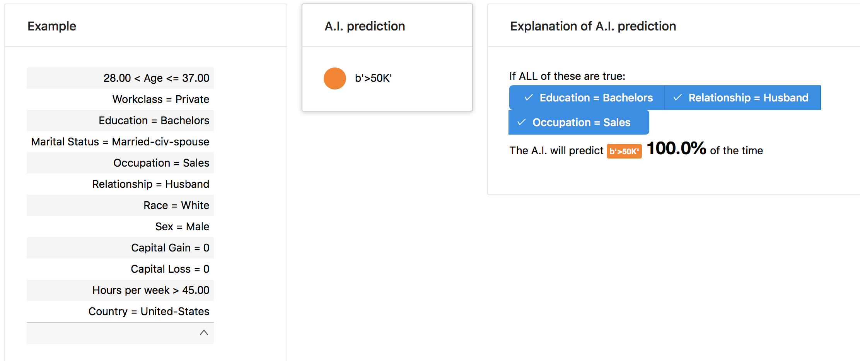
Feature Importance / Selection
Anchor
Ribeiro M T, Singh S, Guestrin C. Anchors: High-precision model-agnostic explanations[C]//AAAI Conference on Artificial Intelligence. 2018. Citation 44

Slide 21
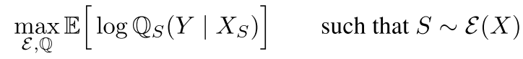
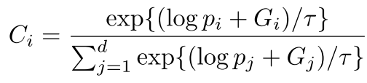
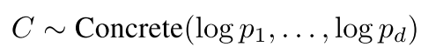
Feature Importance / Selection
L2X
﻿Gumbel-softmax trick
Chen J, Song L, Wainwright M J, et al. Learning to Explain: An Information-Theoretic Perspective on Model Interpretation[J]. ICML, 2018.

Slide 22
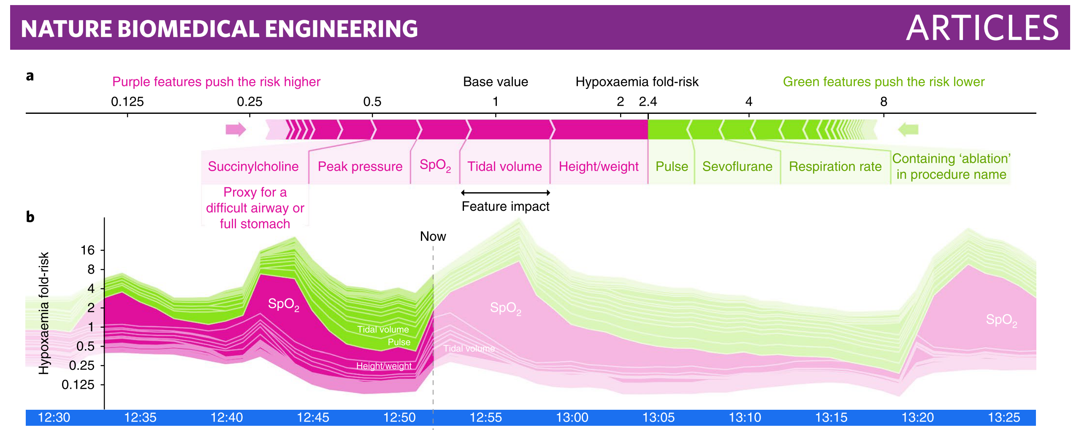
Feature Importance
SHAP
Lundberg S M, Lee S I. A unified approach to interpreting model predictions. NIPS 2017: 4765-4774. Citation 86
Lundberg S M, Nair B, Vavilala M S, et al. Explainable machine-learning predictions for the prevention of hypoxaemia during surgery[J]. Nature Biomedical Engineering, 2018, 2(10): 749.

Slide 23
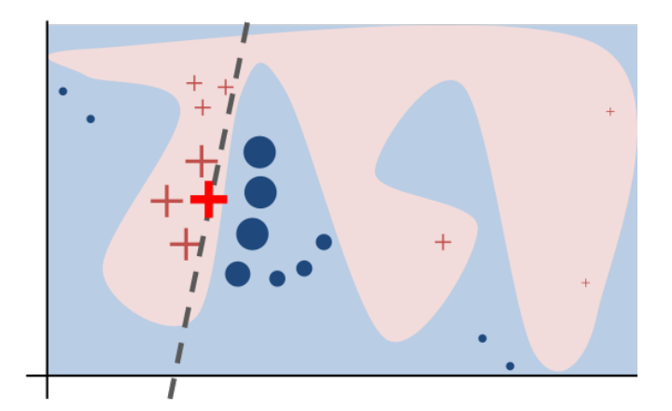
Local Surrogate Model
LIME
Ribeiro M T, Singh S, Guestrin C. Why should i trust you?: Explaining the predictions of any classifier[C]//Proceedings of the 22nd ACM SIGKDD international conference on knowledge discovery and data mining. ACM, 2016: 1135-1144. Citation 877

Slide 24
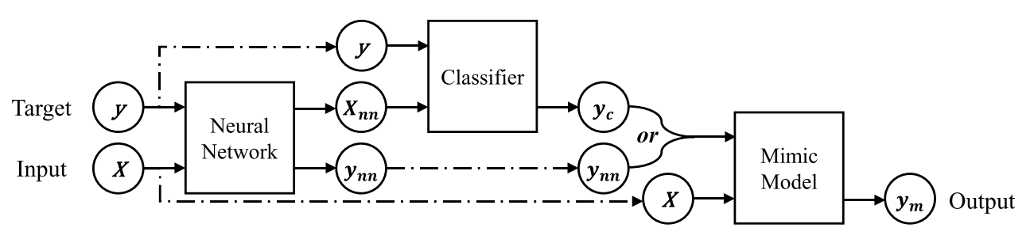
Global Surrogate Model
Mimic learning
Hinton G, Vinyals O, Dean J. Distilling the knowledge in a neural network[J]. arXiv preprint arXiv:1503.02531, 2015.
Che Z, Purushotham S, Khemani R, et al. Distilling knowledge from deep networks with applications to healthcare domain[J]. arXiv preprint arXiv:1512.03542, 2015.

Slide 25
Opportunities

Slide 26
Build Interpretable Model
Intermediate attribute as interpretability
Few(Zero)-shot learning
Ensemble with expert knowledge
Deep feature + expert feature
Model behavior is interpretable
Attention mechanism + visualization (salient map)
Model representation is interpretable
Domain adaption + visualization (t-sne)
Model outcome is interpretable
Basis pattern (composition)
Templates (comparison)
Phenotypes (consistency)

Slide 27
Interpret Agnostic Model
Transform complex model to simpler model
Indirect
Transfer learning (keep model)
Domain adaption (keep representation)
Model distilling, mimic learning (keep outcome)
Direct
Model compression
Transform complex model to more intuitive model
Evidence theory
Fussy system
Logic rules
Feature selection
Interpret with budget
Active learning

Slide 28
One More Thing ...
Model Interpretability -> Data Interpretability
What can we conclude of the data
from data itself
data management
from model
model invariant

Slide 29
Thanks

